Slide 1
Anatomy of pharynx
Prepared by/
Ass. Lecturer: Sara Mostafa

Slide 2
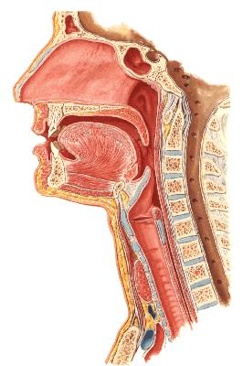

Slide 3
Description
The pharynx is situated behind the nasal cavities, the mouth, and the larynx
It may be divided into nasal, oral, and laryngeal parts
Its upper, wider end lying under the skull
Its lower, narrow end becoming continuous with the esophagus opposite the sixth cervical vertebra

Slide 4
Description
The pharynx has a musculomembranous wall, which is deficient anteriorly
Here, it is replaced by the posterior openings into the nose (choanae), the opening into the mouth, and the inlet of the larynx
By means of the auditory tube, the mucous membrane is also continuous with that of the tympanic cavity

Slide 5
Nasopharynx
Site
Extension
Communication
Relations
Contents

Slide 6
